Slide 1
Data Structures and Algorithms
Algorithm Analysis
Reference:
Data Structures and Algorithm Analysis in Java by Mark A. Weiss

Slide 2
Objectives
You will learn about;
Algorithm
Properties of Algorithm
Complexity
Asymptotic Analysis
Big Oh
Recursion

Slide 3
Algorithm
Any well-defined computation procedure that takes some value, or set of values, as input and produces some value, or set of values, as output
Input
Algorithm
Output

Slide 4
Algorithm
A well-ordered collection of unambiguous and effectively computable operations that, when, executed, produces a result and halts in a finite amount of time.

Slide 5
Properties of an Algorithm
Input -An algorithm has input values from a specified set.
Output -From each set of input values an algorithm produces output values from a specified set. The output values are the solution to the problem.
Definiteness -The steps of an algorithm must be defined precisely.
Correctness -An algorithm should produce the correct output values for each set of input values.

Slide 6
Properties of an Algorithm
Finiteness -An algorithm should produce the desired output after a finite (but perhaps large) number of steps for any input in the set.
Effectiveness -It must be possible to perform each step of an algorithm exactly and in a finite amount of time.
Generality -The procedure should be applicable for all problems of the desired form, not just for a particular set of input values

Slide 7
Algorithm Analysis
The task of determining how much computing time and storage an algorithm requires.
How good is the algorithm?
  Correctness
  Time efficiency
  Space efficiency
  How to analyze algorithms?
  theoretical analysis (Mathematical)
  empirical analysis
  It needs mathematical skills.
Best case, average case, and worst case.

Slide 8
Correctness
An algorithm is said to be correct if, for every input instance, it halts with the correct output.
A correct algorithm solves the given computational problem.
Partial correctness requires that if an answer is returned it will be correct.
Total correctness additionally requires that the algorithm terminates
An incorrect algorithm might not halt at all on some input instance, or it might halt with other than the desired answer.

Slide 9
Space Complexity
Space complexity is the amount of memory used by the algorithm (including the input values to the algorithm) to execute and produce the result.
Algorithm uses memory space for three reasons
  Instruction Space
  Environmental Stack
  Data Space
    Memory used by different data types
How much memory resource, algorithm will require?
We usually consider only Data Space for space complexity
Notes:
Stack: A function may be called inside another function
Data Space: Variables

Slide 10
Time Complexity
Time complexity of an algorithm signifies the total time required by the program to run till its completion.
Time efficiency is analyzed by determining the number of repetitions of the basic operation as a function of input size.
Basic operation: the operation that contributes most towards the running time of the algorithm
Time Efficiency is speed
How long an algorithm takes to produce its result?
We usually use the worst-case time complexity

Slide 11
Cases
Best case is the function which performs the minimum number of steps on input data of n elements.
Worst case is the function which performs the maximum number of steps on input data of size n.
Average case is the function which performs an average number of steps on input data of n elements.
 | Best | Average | Worst
Insertion sort | n | n² | n²
Quick Sort | n log(n) | n log(n) | n²

Slide 12
Asymptotic Analysis
Refers to computing the running time of any operation in mathematical units of computation
It is input bound
If there's no input to the algorithm, it is concluded to work in a constant time

Slide 13
Asymptotic Notations
Following are the commonly used asymptotic notations to calculate the running time complexity of an algorithm
  Big Oh → O()
  Big Omega → Ω()
  Big Theta → θ()
Other notion are
  Little Oh → o()
  Little Omega → ω()

Slide 14
Relative rates of growth
The idea of previous definitions is to establish a relative order among functions. This is the important measure in analysis.
It is not the exact number of basic ops executed for given n rather it is how number of basic operations grows as n increases
T(N) = O(f(N)) says that the growth rate of T(N) is less than or equal to (≤) that of f(N)
T(N) = Ω (g(N)) says that growth rate of T(N) is greater than or equal to (≥) that of g(N).
T(N) = θ (h(N)) says that the growth rate of T(N) equals (=) the growth rate of h(N)
Notes:
T(N) = o(p(N)) says that the growth rate of T(N) is less than (<) the growth rate of p(N).

Slide 15
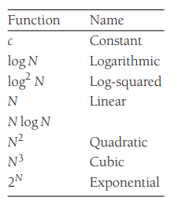
Order of growth
Growth rates

Slide 16
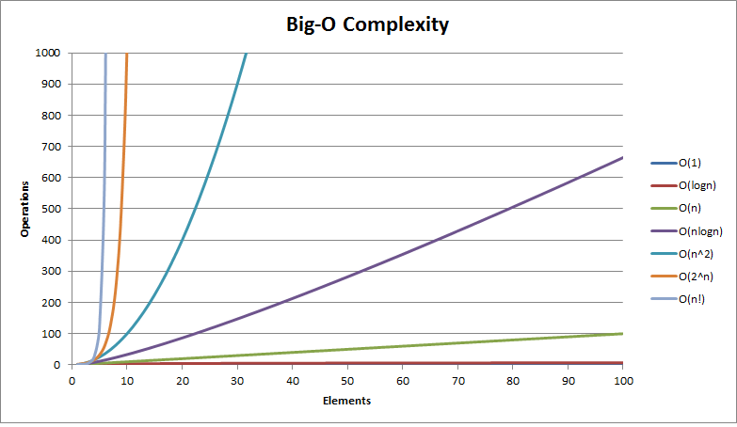
Order of growth

Slide 17
Recursion
It is a method of solving a problem where the solution depends on solutions to smaller instances of the same problem.
  f(x) = 2f(x − 1) + x^2
  f(0) = 0 (Base)
  f(1) = 1,
  f(2) = 6,
  f(3) = 21

Slide 18
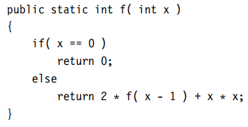
Recursive Method
What will happen If f is called with the value of 4?
What will happen for f(-1)?
Notes:
an attempt to evaluate f (−1) will result in calls to f (−2), f (−3), and so on. Since this will never get to a base case, the program won’t be able to compute the answer.

Slide 19
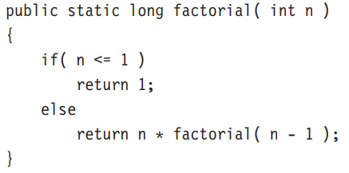
Analyzing Recursive Methods
Factorial: 5! → 5.4.3.2.1
If the recursion is really just a thinly veiled for loop, the analysis is usually trivial. For instance, the following method is really just a simple loop and is O(N):

Slide 20
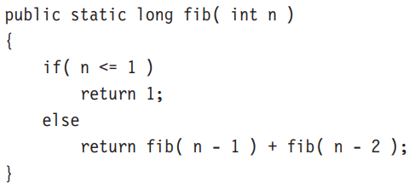
Analyzing Recursive Methods
Fibonacci Series: 1, 1, 2, 3, 5, 8 . . . .

Slide 21


Analyzing Recursive Methods
$$O(2^{n})$$
Notes:
the running time of this program grows exponentially.

Slide 22
Review Questions
Question 1:
Describe properties of an algorithm?
Question 2:
What is base case in recursion?

